Slide 1
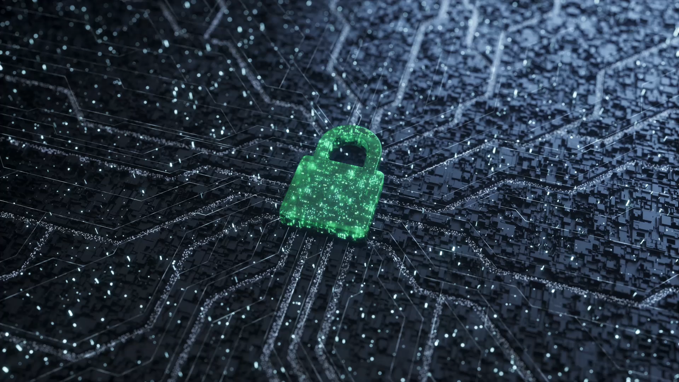
Digital Security Threat Analysis
Shadath Islam, Omar Elhossary, Rohan Shanbhag, Adriel Zachariah

Slide 2
Introduction: Rise of Threats
The healthcare industry is increasingly reliant on digital technology to manage patient data, deliver care, and ensure smooth operations. However, this digital transformation has also made hospitals a prime target for cybercriminals.
According to a recent report by HIMSS Cybersecurity, healthcare data breaches increased by a staggering 79% in 2023. These attacks can have devastating consequences, compromising patient privacy, disrupting critical operations, and resulting in significant financial losses.

Slide 3
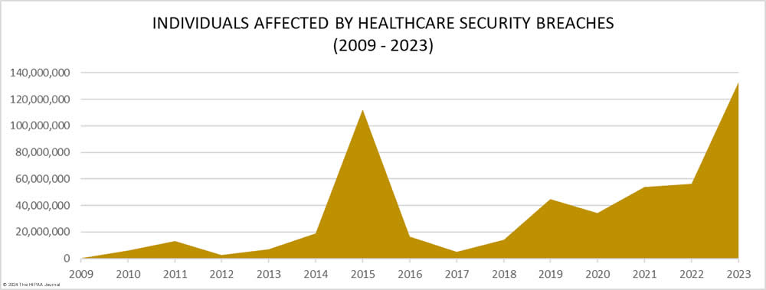
Current State of Cyber Threats
Data Breaches:
As the graph illustrates, healthcare data breaches have been on a sharp rise in recent years. In 2023 alone, over 133 million patient records were compromised according to the HIPAA Journal. These breaches often involve sensitive patient information such as names, Social Security numbers, and medical histories.
Ransomware Attacks:
In May 2021, a major ransomware attack crippled Hollywood Presbyterian Medical Center in Los Angeles. The attack, linked to the cybercriminal group REvil, encrypted critical hospital systems, including electronic health records and appointment scheduling software. This disruption forced the hospital to divert ambulances and postpone elective surgeries for several days, potentially delaying critical care for some patients. The attack also highlighted the growing sophistication of cybercriminals targeting healthcare institutions.
Impact on Healthcare:
Cyberattacks on healthcare organizations can have devastating consequences. Disruptions to patient care can lead to delays in critical treatments, while financial losses can strain hospital resources. Additionally, compromised patient data can damage a hospital's reputation and erode trust within the community.

Slide 4
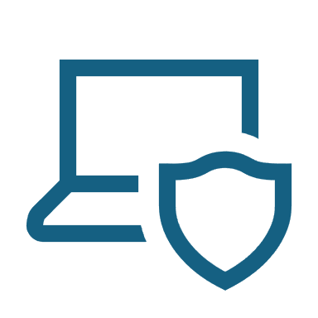
Common Modes of Cyber Attacks
Phishing:
Phishing attacks are a common tactic used by cybercriminals to steal sensitive information from healthcare professionals. These emails often appear to be from legitimate sources such as healthcare providers, insurance companies, or government agencies. They may trick recipients into clicking malicious links or downloading attachments containing malware that can steal patient data or disrupt hospital systems.
For instance, a recent phishing campaign targeted healthcare workers with emails claiming to be from a reputable medical software company. The emails contained a link that, when clicked, downloaded malware designed to steal login credentials for electronic health records systems.
Ransomware:
Ransomware is a type of malware that encrypts a victim's data, rendering it inaccessible. Healthcare organizations are prime targets for ransomware attacks because they often rely heavily on digital systems to store patient data and manage critical operations. Ransomware can enter hospital systems through various means, including phishing emails with malicious attachments, vulnerabilities in outdated software, or compromised remote access points.
Once a system is infected, ransomware encrypts data, preventing authorized users from accessing it. The attackers then demand a ransom payment in exchange for a decryption key. If the ransom is not paid, the attackers may threaten to permanently delete the data or leak it online.
Insider Threats:
While most cyberattacks originate from outside sources, healthcare organizations also face threats from within. Malicious insiders, such as disgruntled employees or contractors, may deliberately steal or sell patient data for personal gain. Even negligent insiders can pose a risk by accidentally exposing sensitive information due to a lack of cybersecurity awareness.
Denial-of-Service (DoS) Attacks:
A DoS attack aims to overwhelm a computer system with a flood of traffic, making it unavailable to legitimate users. In a healthcare setting, a DoS attack could target hospital websites, appointment scheduling systems, or even internal communication networks. This can prevent doctors, nurses, and other staff from accessing critical patient information or disrupt communication during emergencies.

Slide 5
Case Study
In September 2021, MedStar Health, a large healthcare system on the East Coast with over 30 hospitals, experienced a major ransomware attack. The attack, attributed to the cybercriminal group Ryuk, encrypted critical data across MedStar's network, disrupting operations at numerous facilities.
Importance of Preparedness: Even large healthcare systems with significant resources are vulnerable to cyberattacks. Having a comprehensive cybersecurity plan and practicing incident response procedures are crucial for minimizing disruption.
Employee Training: Social engineering tactics like phishing emails were suspected in the MedStar attack. Regular security awareness training for staff can help employees identify and avoid these threats.
Data Backups: Maintaining secure and regularly updated data backups allows for faster recovery in the event of a ransomware attack.

Slide 6
Best Practices in Digital Security
Train Staff: Empower staff to identify suspicious activity through security awareness training.
01
Restrict Access: Limit access to sensitive data with strong authentication and least privilege policies.
02
Encrypt Data: Scramble patient information at rest and in transit with encryption.
03
Regular Audits: Identify security weaknesses proactively through regular audits and penetration testing.
04

Slide 7

Future Threat Landscape
Emerging Threats:
AI-powered attacks: Cybercriminals may leverage AI to automate tasks and launch more sophisticated attacks.
Attacks on medical devices: Connected medical devices could become targets for attackers seeking to disrupt care or steal patient data.
Technological Advancements:
AI and IoT: New technologies like AI and the growing number of interconnected medical devices create a complex environment with potential security challenges.

Slide 8
Conclusion Thank You!
The digital landscape of healthcare presents both immense opportunities and significant security challenges. Cyberattacks pose a growing threat to patient data privacy, operational efficiency, and the overall quality of care. By implementing robust security measures, investing in employee training, and staying informed about emerging threats, healthcare institutions can build a strong defense against these attacks.

Slide 9
Sources
https://www.hipaajournal.com/healthcare-data-breach-statistics/
https://www.himss.org/resources/himss-healthcare-cybersecurity-survey
https://ocrportal.hhs.gov/ocr/breach/breach_report.jsf
https://www.latimes.com/business/technology/la-me-ln-hollywood-hospital-bitcoin-20160217-story.html
https://www.inforisktoday.com/medstar-shuts-systems-after-cyberattack-a-8999
https://darktrace.com/blog/recycling-ransomware-the-return-of-ryuk
https://blog.checkpoint.com/security/a-continuing-cyber-storm-with-increasing-ransomware-threats-and-a-surge-in-healthcare-and-apac-region/
https://www.himss.org/resources/himss-healthcare-cybersecurity-survey
https://www.pwc.com/us/en/industries/health-industries/library/ai-in-healthcare.html

